Slide 1
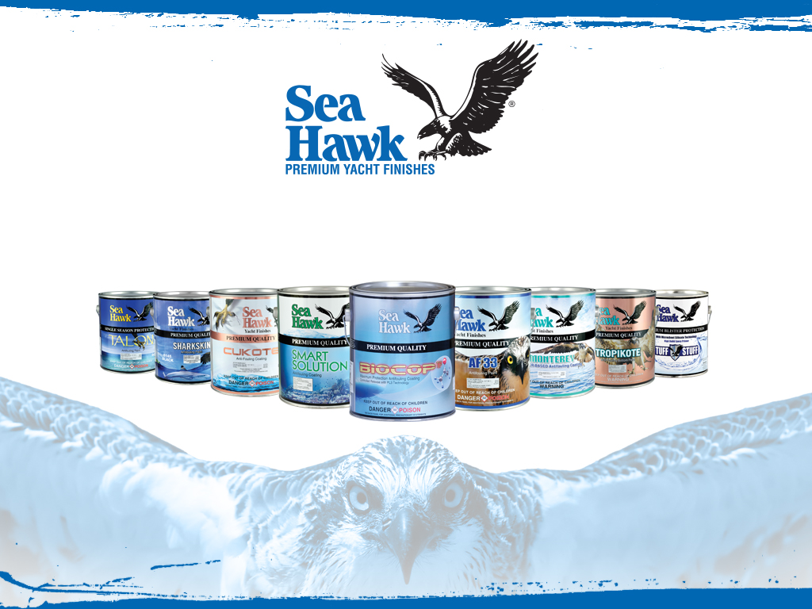
Manufacturing Plant Tour 2016

Slide 2
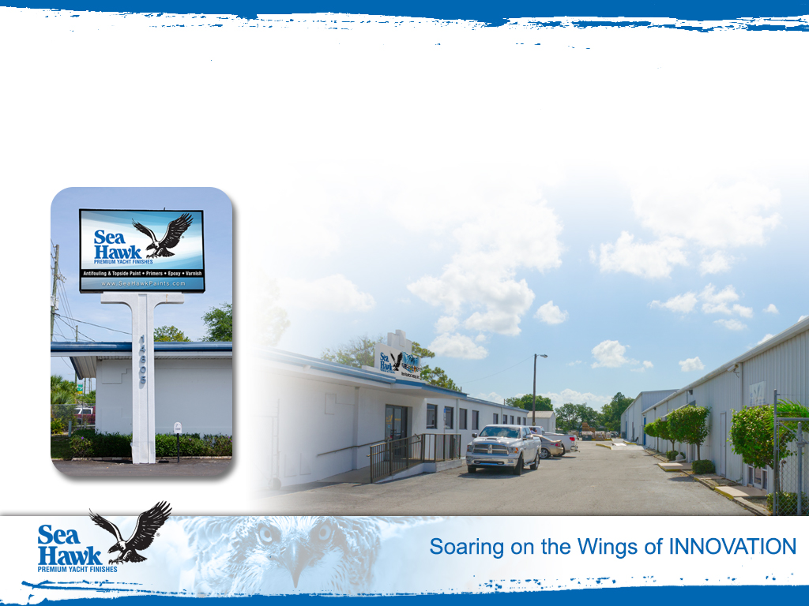
The Sea Hawk Paints factory campus is located at
14805 49th Street North, Clearwater, Florida.

Slide 3
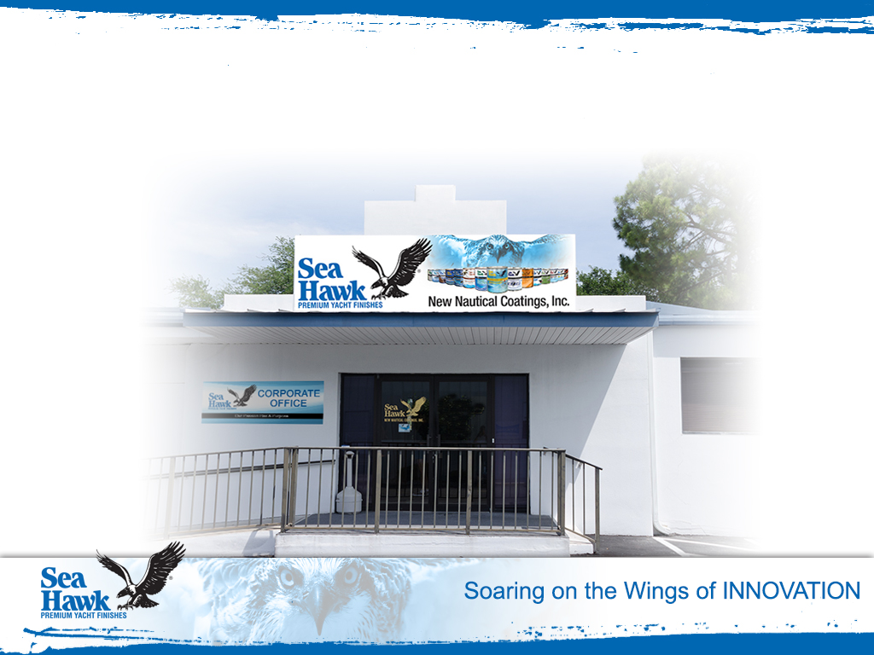
Sea Hawk Corporate Office

Slide 4
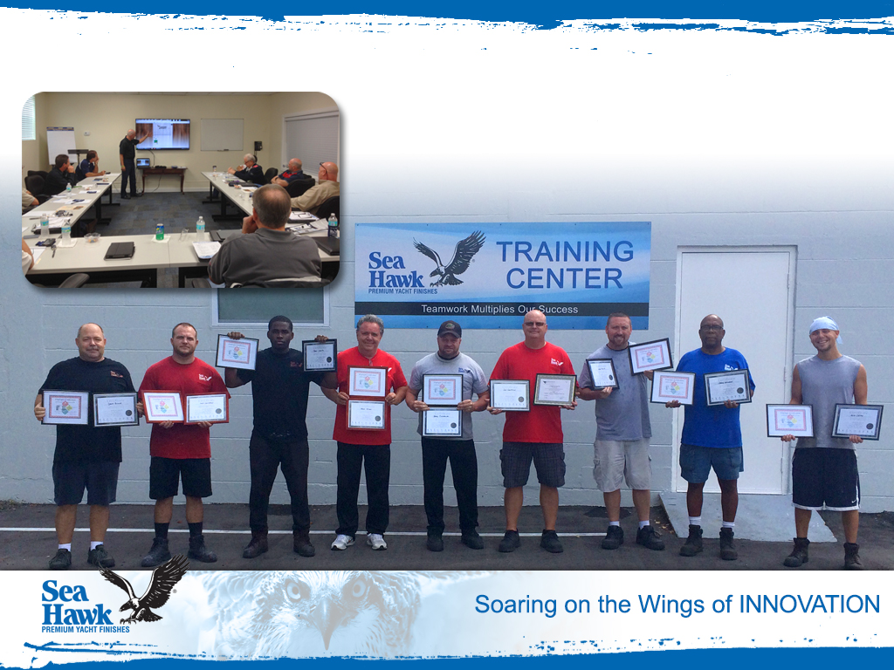
Sea Hawk Training Center

Slide 5
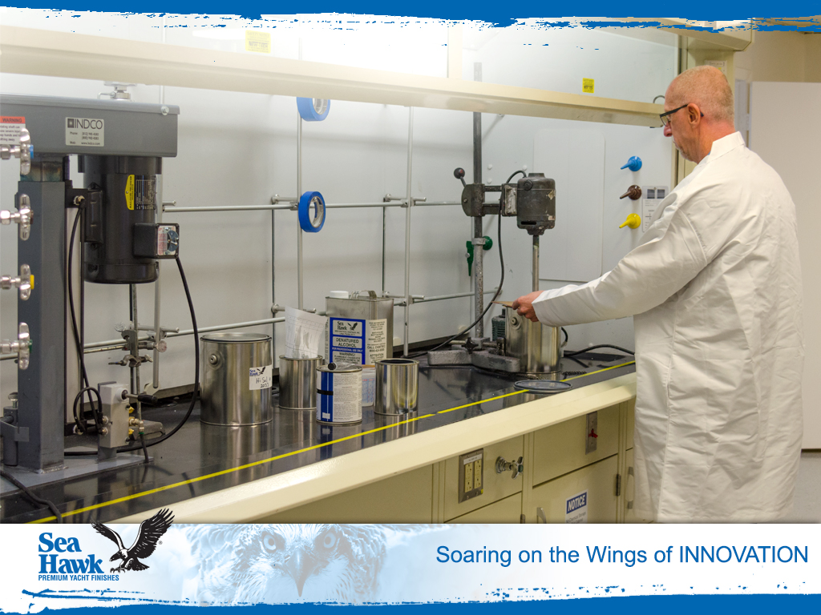
Sea Hawk R&D Center

Slide 6
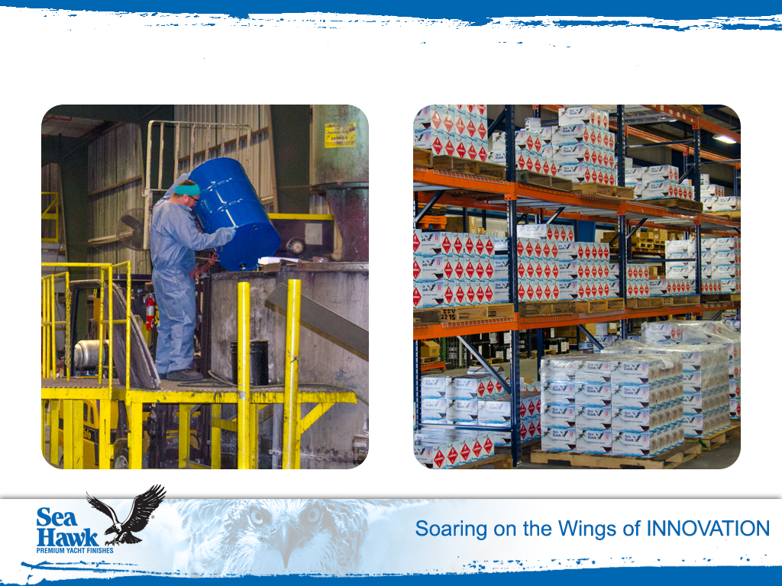
Manufacturing & Finished Goods Warehouse

Slide 7
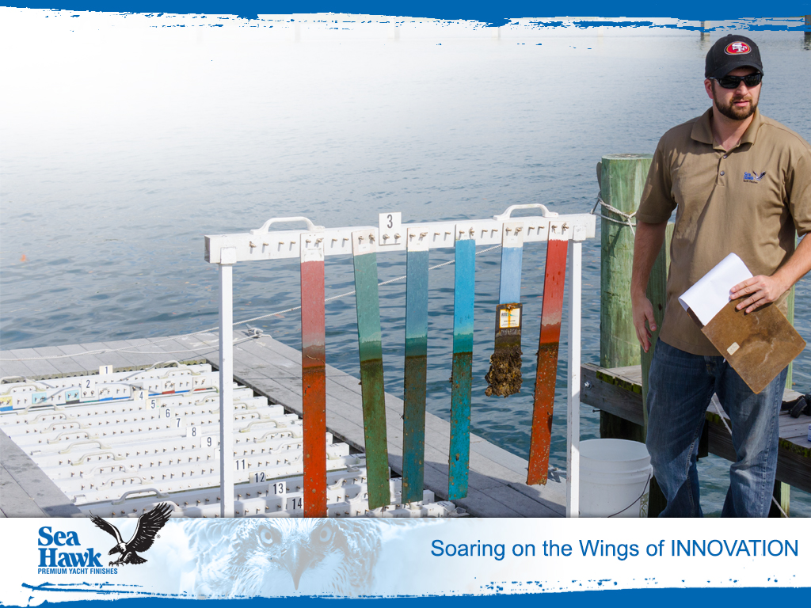
Sea Hawk Paints
Antifouling Test Raft

Slide 8
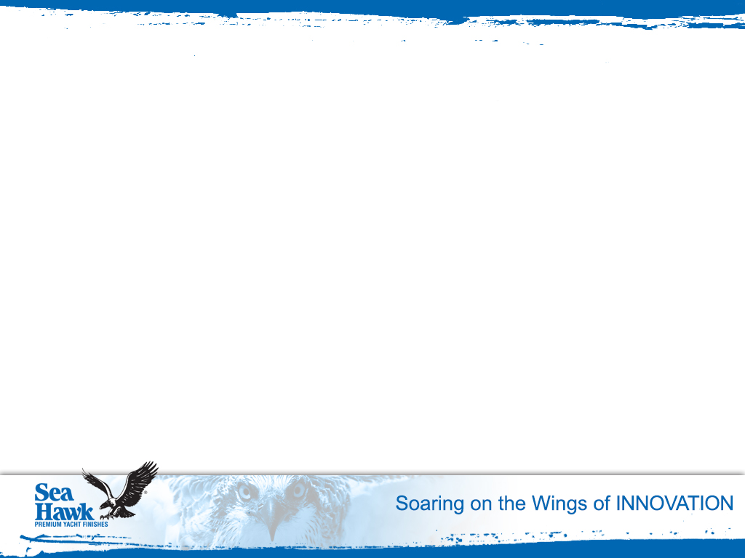
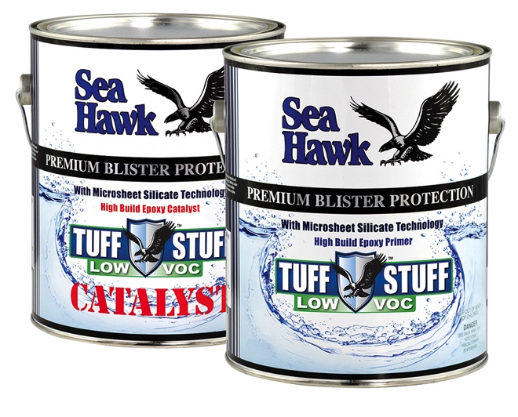
New!
TUFF STUFF Low VOC
Use over blistered fiberglass as a repair coat, and over non-blistered fiberglass as a barrier coat.
Protects metals from corrosion, including: aluminum, bronze, stainless steel, cast iron and lead – above and below the waterline.
Excellent for priming props, shafts, keels, trim tabs, thru hulls and lower units
Highest build epoxy – Fewer coats needed
Longer window between coats makes Tuff Stuff Low VOC easy to use
Reduced labor and less haul out time
Low VOC – 280 grams/liter

Slide 9
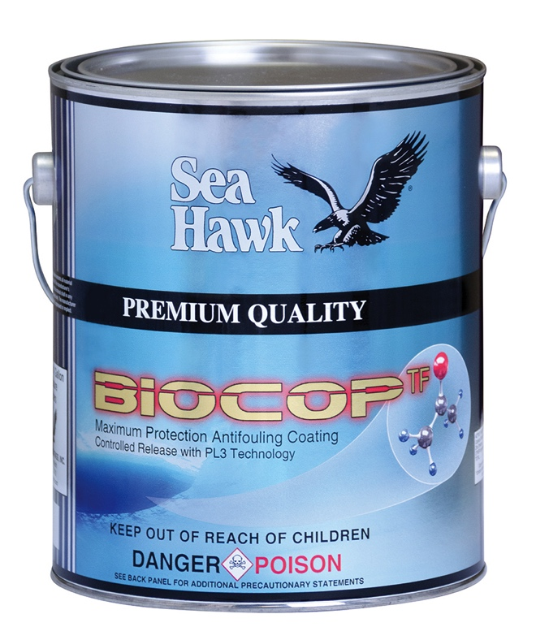
BIOCOP TF
1200-1 Series
Advanced Dual-Biocide
for Maximum Protection
Maximum protection antifouling available
Advanced dual-biocide PL3 release technology
Harder self-polishing boosted ablative antifoulant for longer life
Multi-Season performance
Performs in fresh or saltwater
Approved for vessels of all sizes
Lloyd’s Registry certified

Slide 10
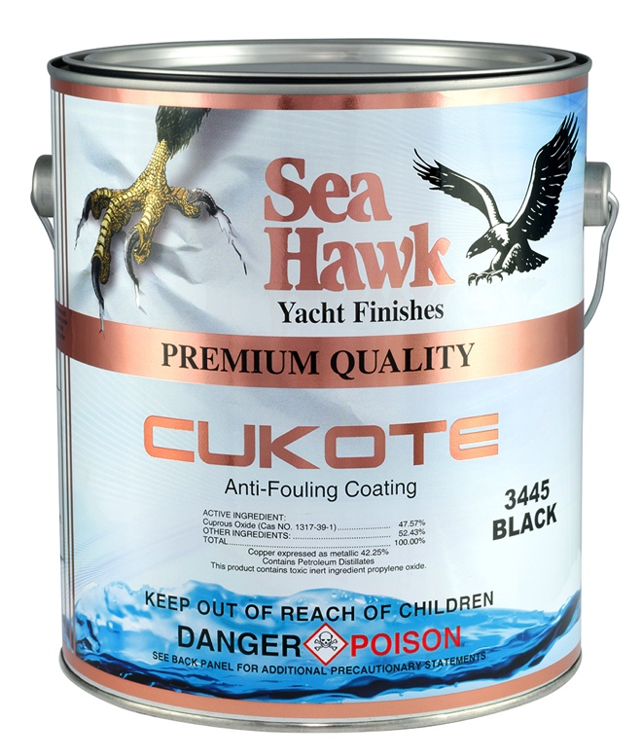

CUKOTE
3400 Series
Enhanced Self-Polishing
Copolymer Antifouling
Used by many boat builders
Self-polishing coating eliminates heavy buildup of paint
May be taken in and out of the water without affecting antifouling properties
Harder self-polishing formula
for higher speeds
Widest range of colors for
copper-based paints
Approved

Slide 11
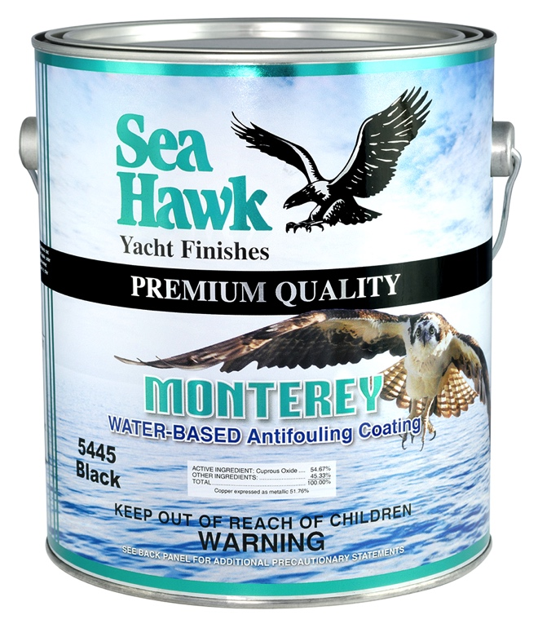
MONTEREY
5400 Series
Water-Based • Low VOC
Premium water-based antifouling
Low VOC’s and highest grade of cuprous oxide available (more potent active ingredient)
Harder ablative finish (lasts longer on higher speed vessels)
Better color consistency for color matching
Consistent viscosity = better flow and rolling ability
May be applied over other ablative antifoulant paints

Slide 12
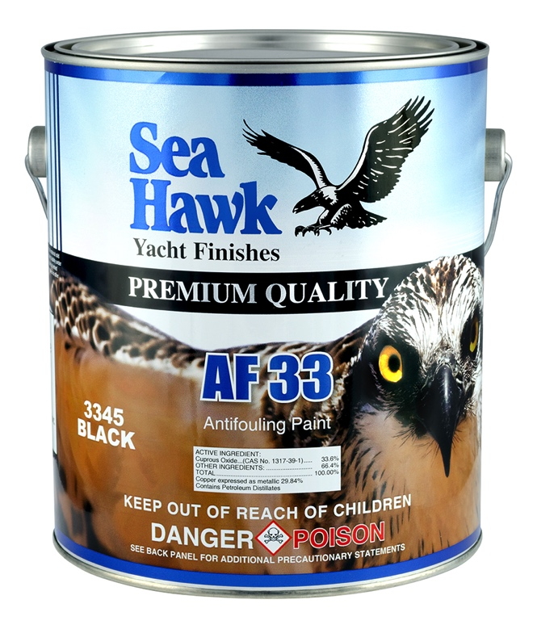
AF-33
3300 Series
Multi-Season Formula
at Single Season Price
Harder durable finish
for all types of vessels
Dependable performance
PL3 Release Technology
Approved

Slide 13
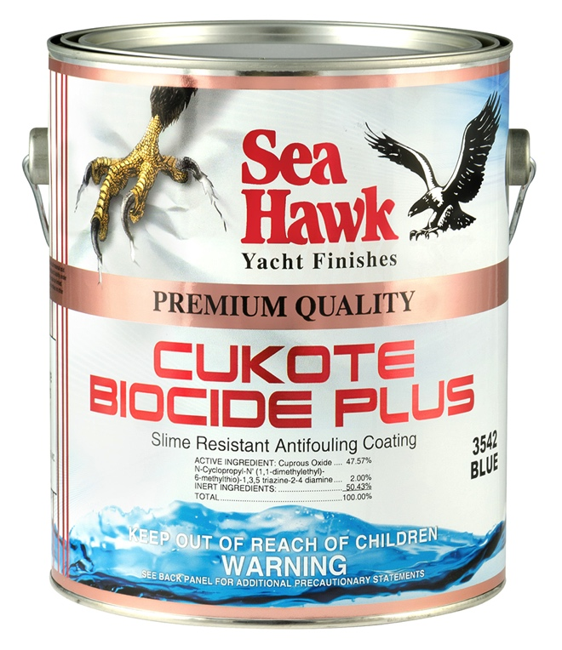
CUKOTE BIOCIDE PLUS
3500 Series
Ablative Copolymer
with Slime Resistance
Dual biocides with Slime Control
Highest Quality Ablative Product on the Market
Ablative Coating Eliminates Heavy Buildup of Paint
Self Polishing with Slime Resistance
May Be Taken In and Out the Water Without Affecting

Slide 14
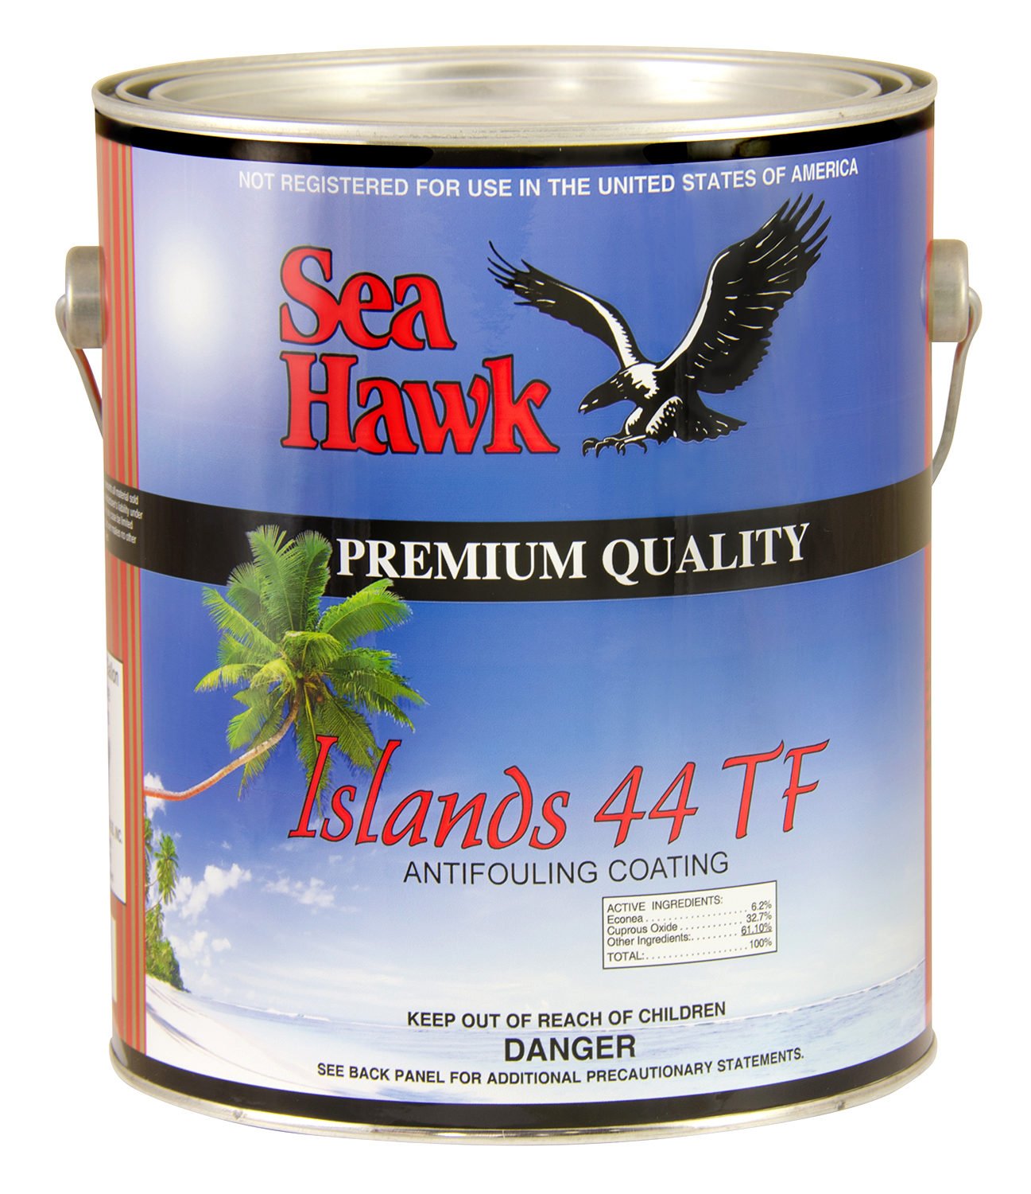
ISLANDS 44 TF
1000TF Series
A Self-Cleaning Co-Polymer Antifouling Bottom Paint formulated for use in
Caribbean waters
Developed for the harshest tropical environments
Self-polishing ablative
Tin-FREE
Low load of copper

Slide 15
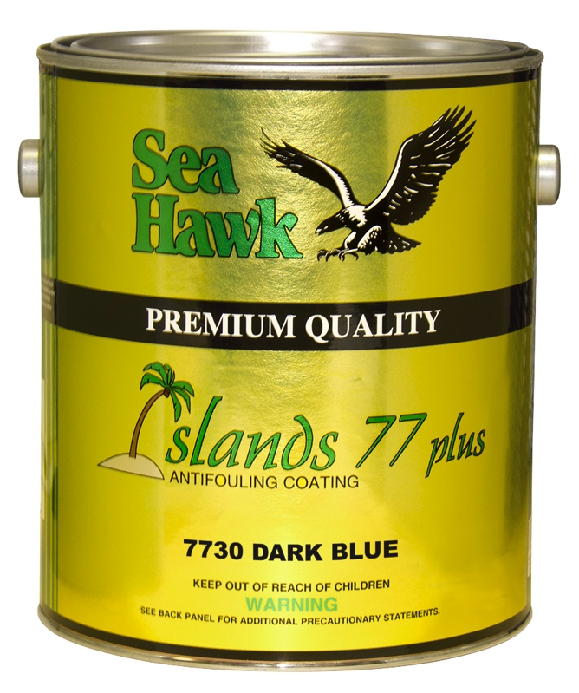
ISLANDS 77 Plus
7700 Series
Alternative Tin-Free
with High Copper Content
More environmentally friendly
Proven in all waters
Advanced Biocide Technology
Self-polishing polymer
binding system
Approved

Slide 16
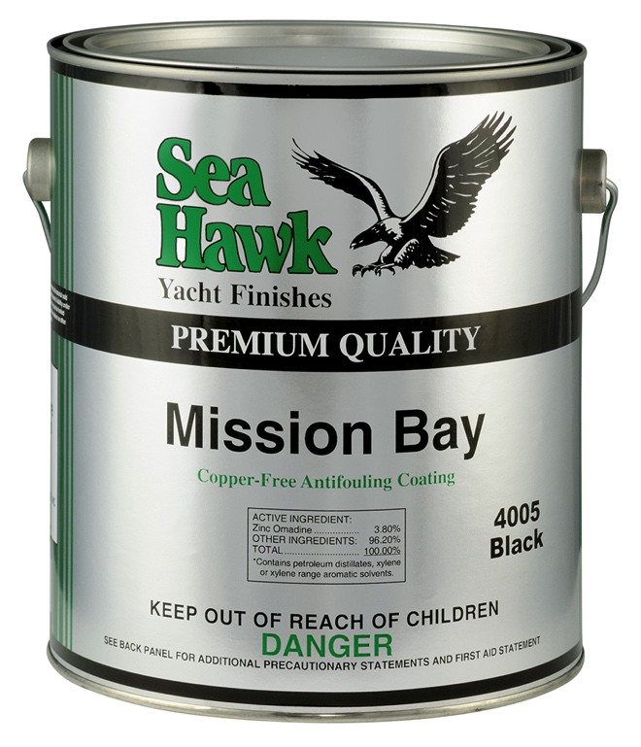
MISSION BAY
4000 Series
Environmentally Friendly Antifoulant
UV-reactive biocide
The most advanced non-metal biocide available
No barrier coat needed over most antifouling paints
Ideal for all types of craft – fiberglass to aluminum
Helps prevent electrolysis
Approved

Slide 17
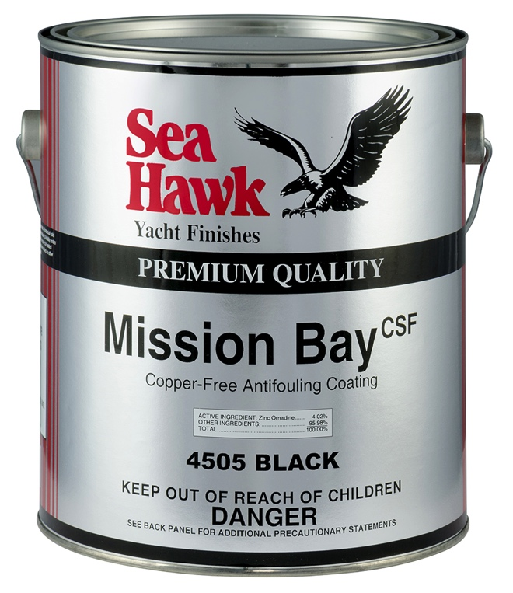
MISSION BAY CSF
4500 Series
Copper-Free Nano-Based Technology
Water-based bottom paint
Safest, environmentally-friendly antifouling paint on the market
Over 80% lower VOC's than solvent-based
Completely eliminates the leaching of copper compounds into the environment

Slide 18
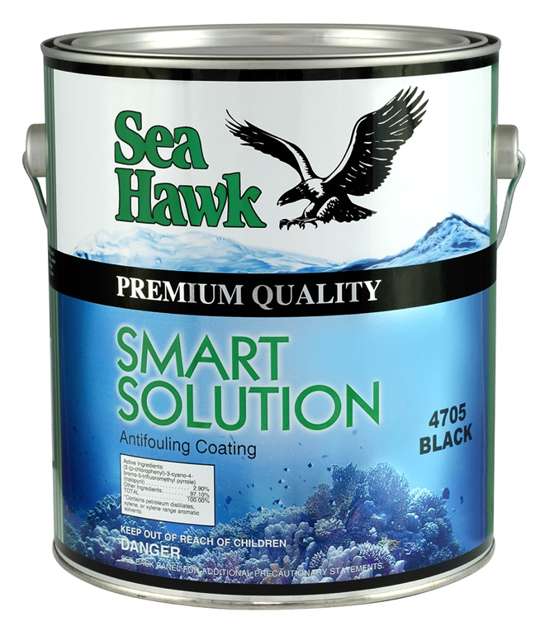
SMART SOLUTION
4700 Series
Powerful, Environmentally Friendly Antifoulant
Completely METAL-FREE antifoulant
Guaranteed for 1 year
against growth
Compatible over existing antifoulants
Aluminum safe - Outdrives
Available in white
Approved

Slide 19
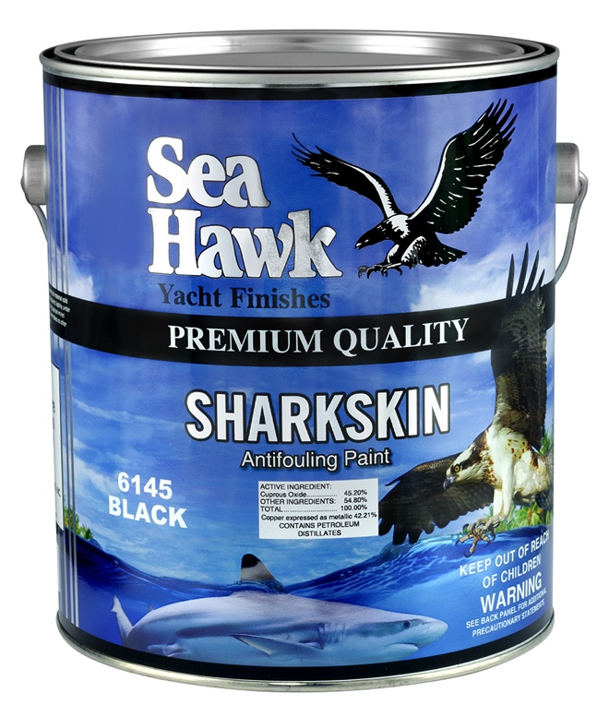
SHARKSKIN
6100 Series
50% Copper Heavy
Duty Protection
Hard modified epoxy
Effective copper content
May be applied over any existing bottom paint
For fresh or salt water

Slide 20
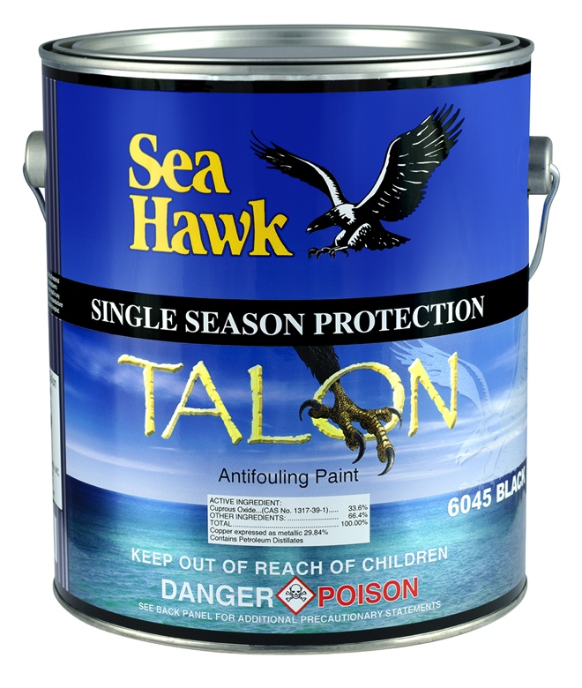
TALON
6000 Series
Dependable Performance
at an Affordable Price
Compatible with most
antifouling paints
Durable finish for all types
of vessels
Single season protection

Slide 21
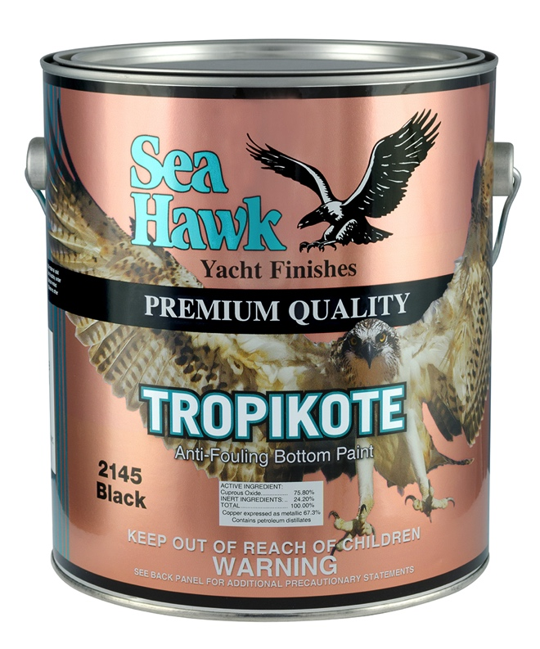
TROPIKOTE
2100 Series
Over 75% Copper
Highest copper content
available on the market
Scrubbable hard modified epoxy
Aggressively combats growth in extreme tropical conditions
Outperforms similar paints on the market

Slide 22
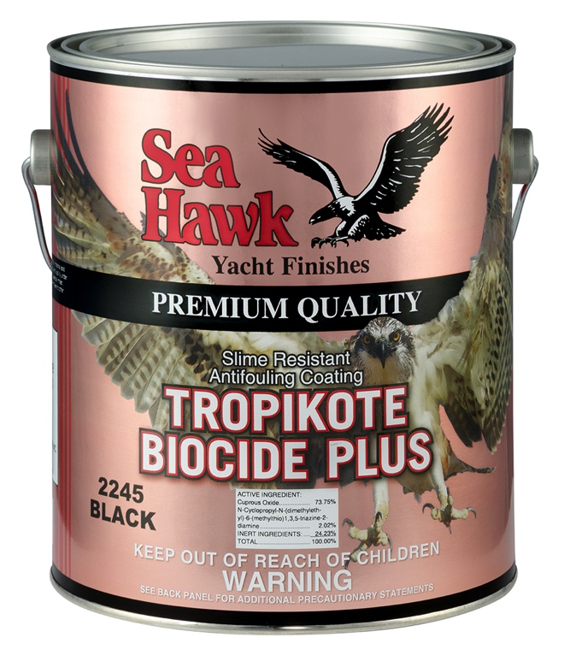
TROPIKOTE BIOCIDE PLUS
2200 Series
Highest Load of Copper
and Dual Biocide
Slime resistant
Scrubbable
Compatible with most hard antifoulants
Hard finish
73% copper content
Formulated for extreme tropical conditions

Slide 23
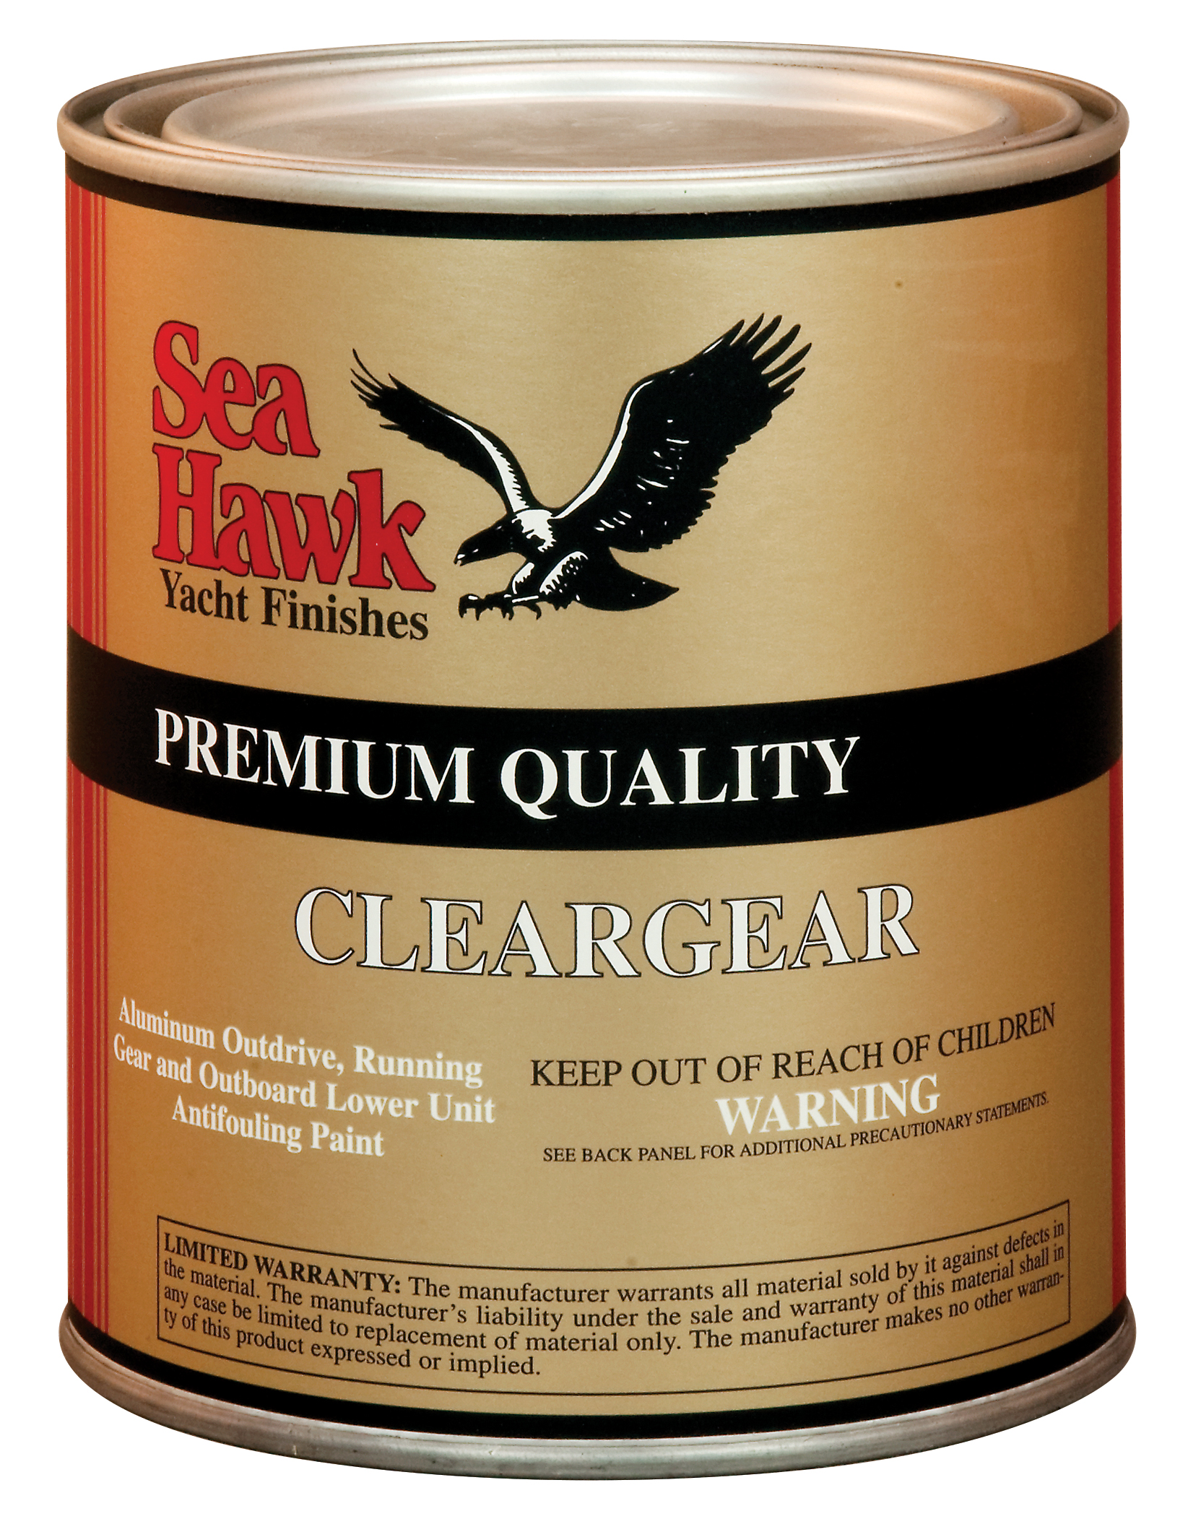
CLEARGEAR
1400 Series
Running Gear Antifouling
No primer needed
Use on aluminum outdrive, running gear and outboard lower unit

Slide 24
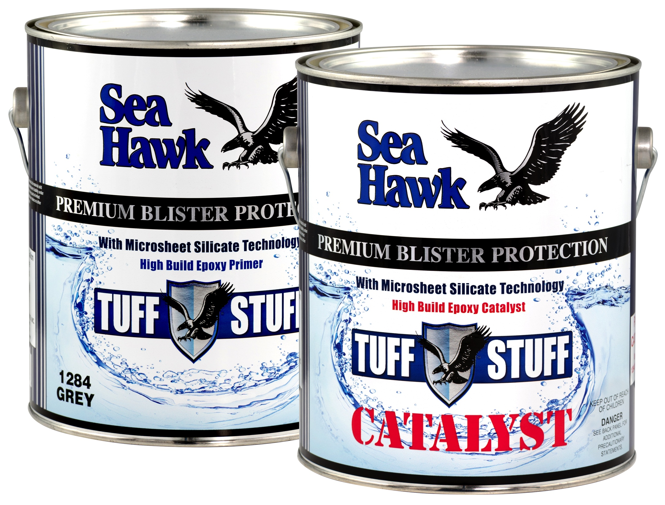
TUFF STUFF
1284 Gray • 1285 White
Premium Blister Protection with Microsheet Silicate Technology
Premium osmosis protection
Highest build epoxy primer
Fewer coats needed
Longer window between coats
Reduced labor and
haul out time

Slide 25
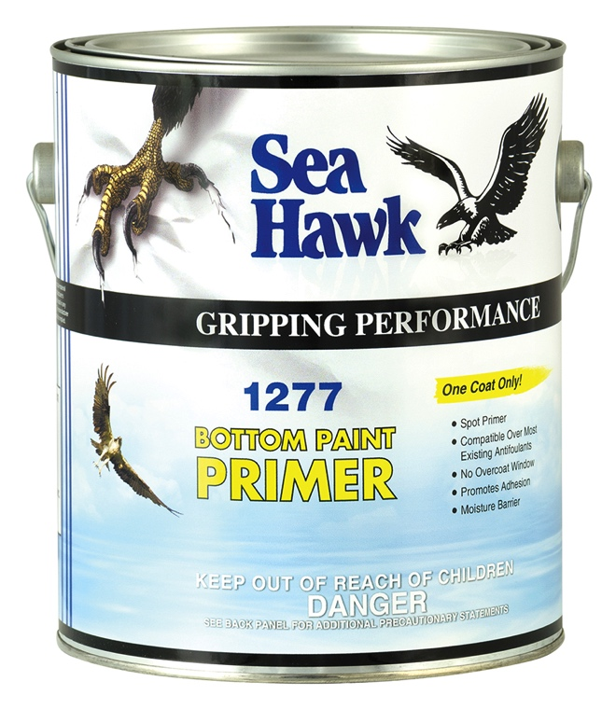
BOTTOM PAINT PRIMER
1277
Premium Water Barrier
Great for use over any existing bottom paint
Anticorrosive properties
Adhesion promoter
No overcoat window

Slide 26
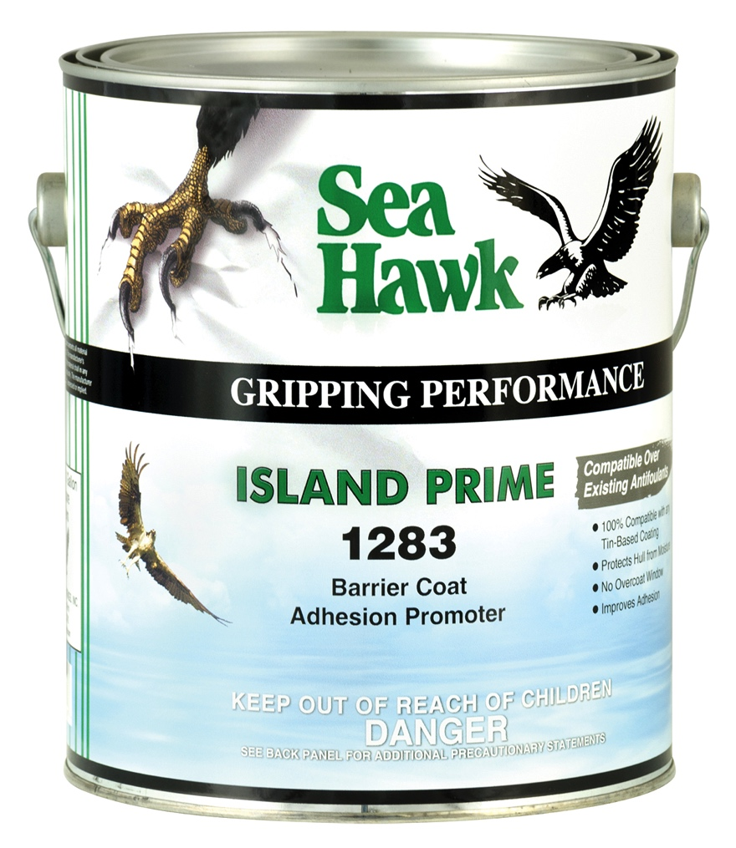
ISLAND PRIME
1283
Excellent Adhesion Promoter
TBT sealer
Adhesion promoter
No overcoat window

Slide 27
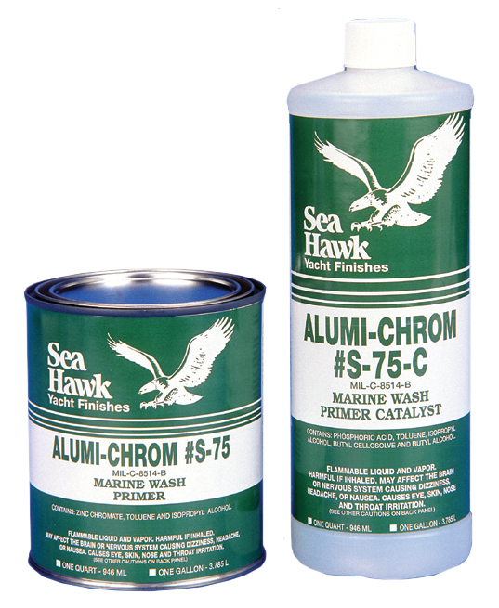
ALUMI-CHROME
S-75
Chemical Bonding to Metal
Anticorrosive properties
Adhesion promoter

Slide 28
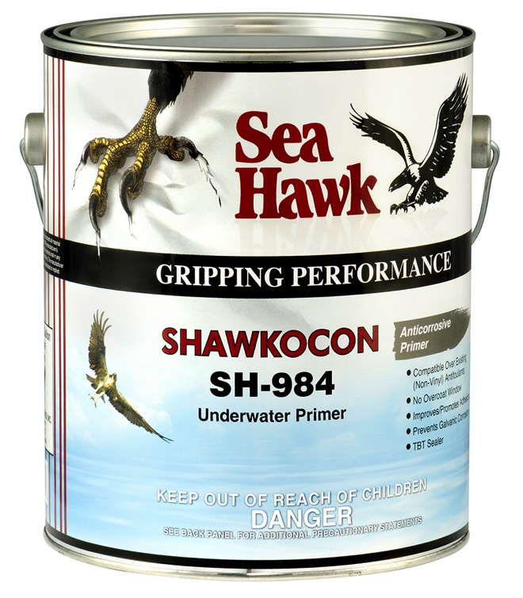
sHAWKocon
SH984
Underwater Primer & Adhesion Promoter
Anti-Corrosive Primer
Compatible Over Existing (Non-Vinyl) Antifoulants
No Overcoat Window
Improves & Promotes Adhesion
Prevents Galvanic Corrosion
TBT Sealer

Slide 29
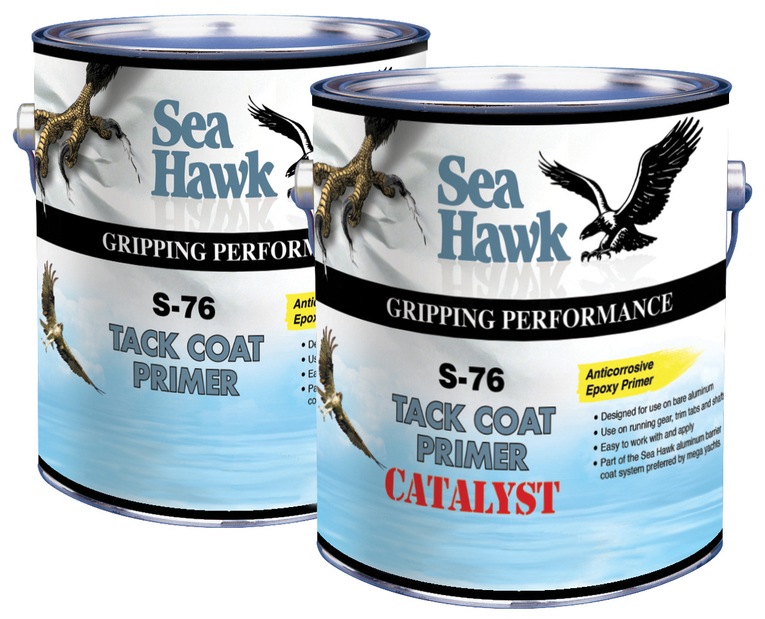
TACK COAT PRIMER
S-76
Designed for Use on
Bare Aluminum
Underwater primer
A mega yacht favorite
For use on running gear, trim tabs, and shafts

Slide 30
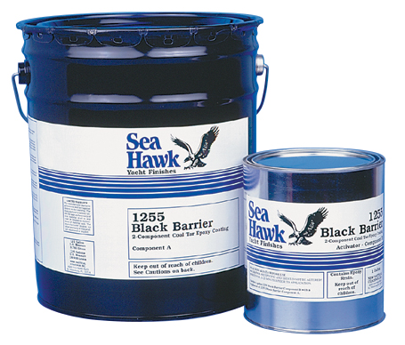
BLACK BARRIER COAT
1255
The Best Product for Aluminum & Steel
#1 Product for Mega Yacht Metal Protection
Extremely High Build

Slide 31
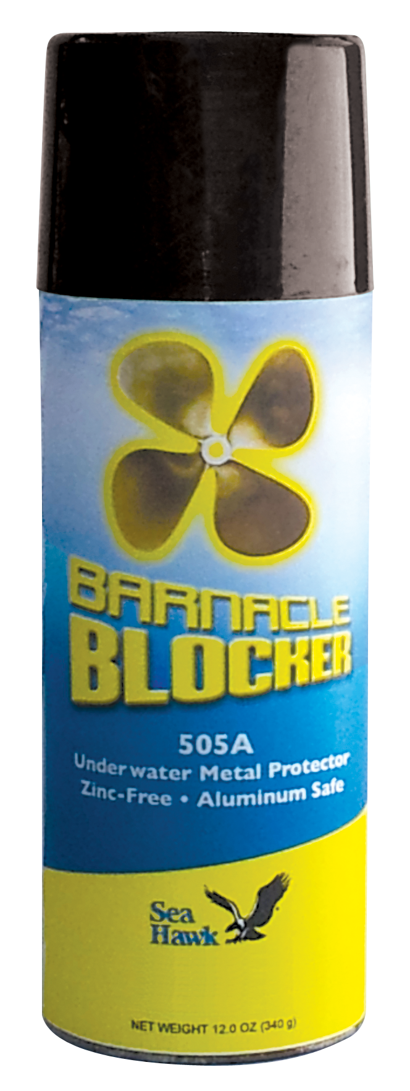
BARNACLE BLOCKER
Anti-corrosive Primer
for Metals
Formulated for underwater metal protection
Self-cleaning
Reduces galvanic corrosion

Slide 32
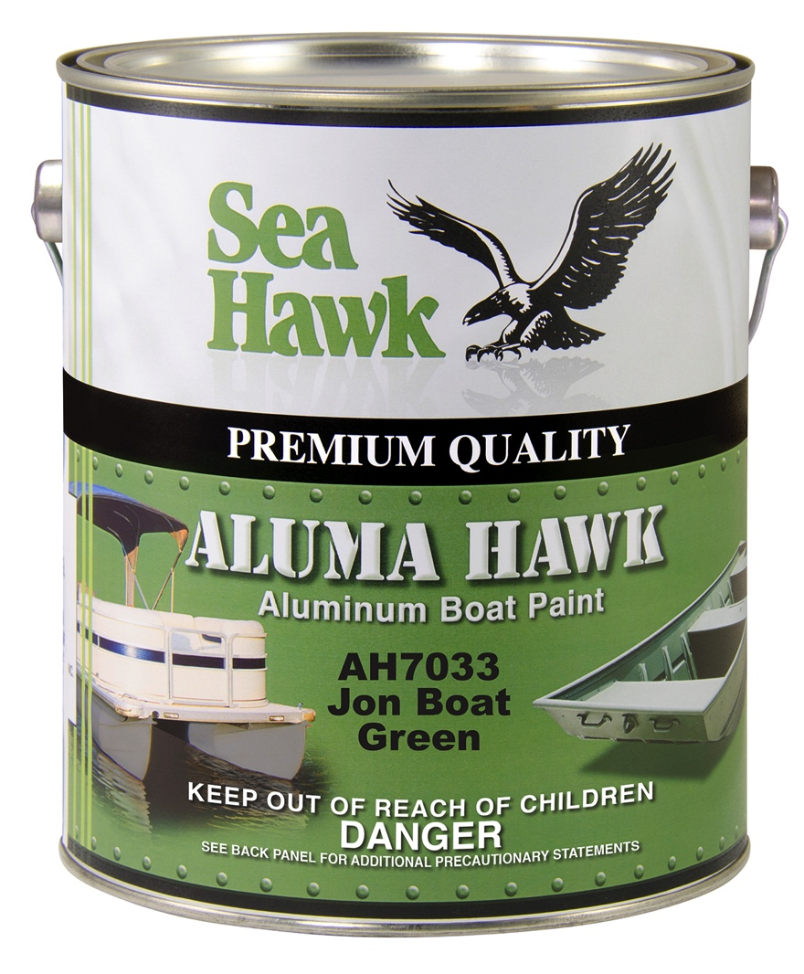
ALUMA HAWK
AH7000 Series
Aluminum Boat Paint
Rust-inhibiting and lift-resistant primer for lacquer/enamel based topcoats
Excellent adhesion on aluminum
Use as a primer and or topcoat on raw aluminum, fiberglass and other substrates
One-Step application ideal for pontoon boats and jon boats
Safe for fresh or saltwater submersion

Slide 33
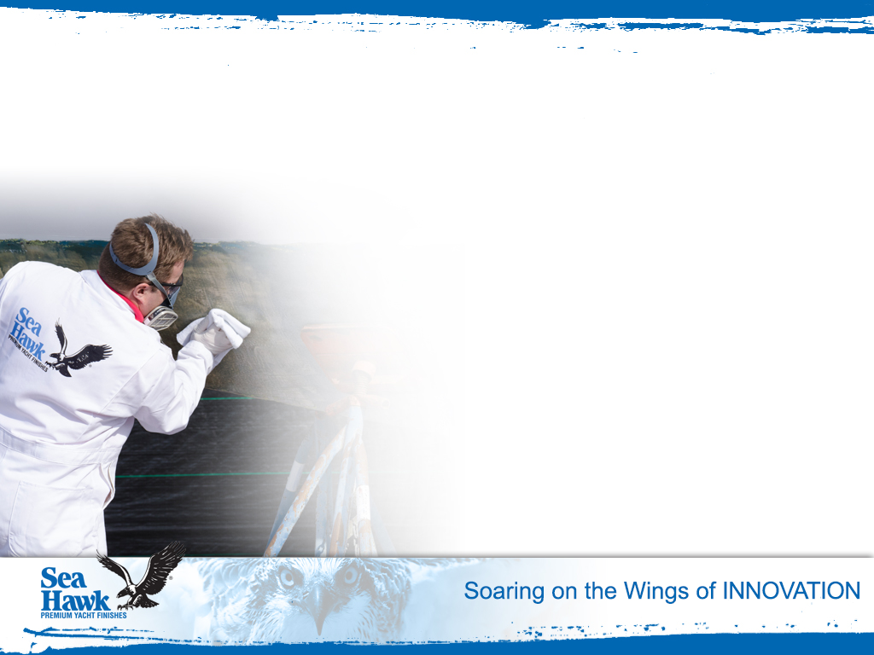
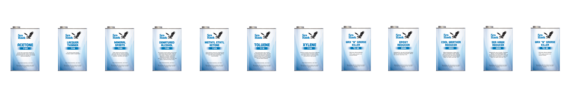
Reducers, Thinners, Cleaners & Solvents
Reducers
2031 Islands 44 Plus Reducer
2033 Reducer
2035 Hot Weather Reducer
Cleaners
Wax “N” Grease Killer (S-80)
S-90 Wax & Degreaser
Solvents
Acetone (7120)
Denatured Alcohol (7105)
Lacquer Thinner (7110)
Methly Ethyl Ketone (7125)
Mineral Spirits (7100)
VM&P Naptha (7135)
Toluene (7115)
Xylene (7130)

Slide 34
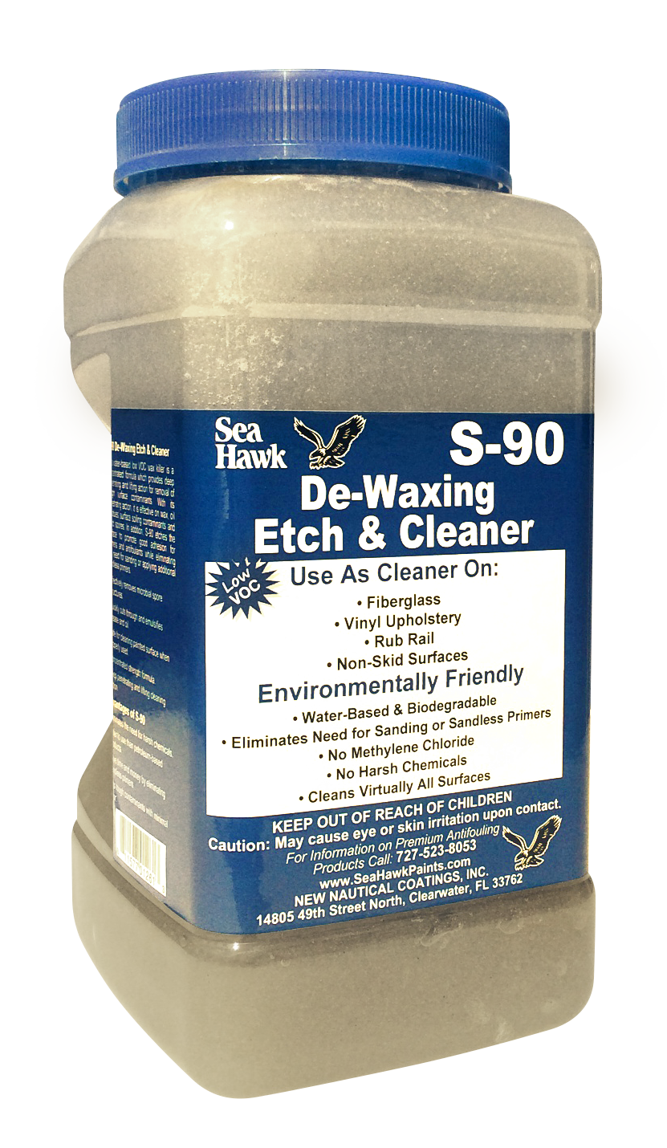
S-90 DE-WAXING ETCH & CLEANER
Ultra-low VOC, Water-Based Formula with Deep Penetrating and Lifting Qualities.
No Harsh Chemicals
Eliminates the Need for Sanding
Water-Based and Biodegradable
No Methylene Chloride
Cleans Virtually all Surfaces

Slide 35
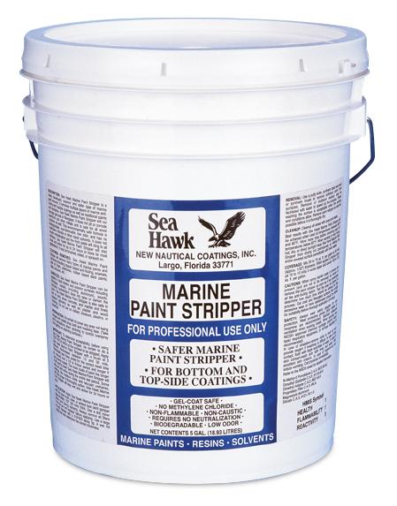
PAINT STRIPPER
1280
Removes Most Marine Paints and Varnishes
Use on bottom or topside paints
Biodegradable
No methylene chloride
Environmentally friendly
Fast working

Slide 36
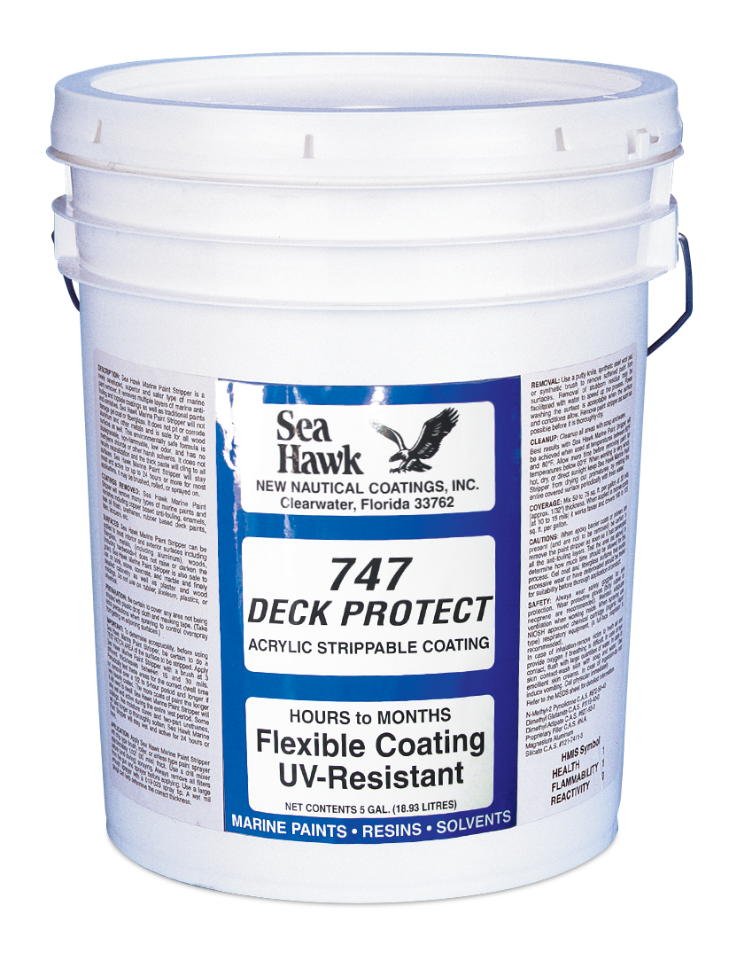
DECK PROTECT
747
Flexible Protective Coating
Use to protect fiberglass
Acrylic strippable water-borne coating
No strong solvents
Flexible UV-resistant coating

Slide 37
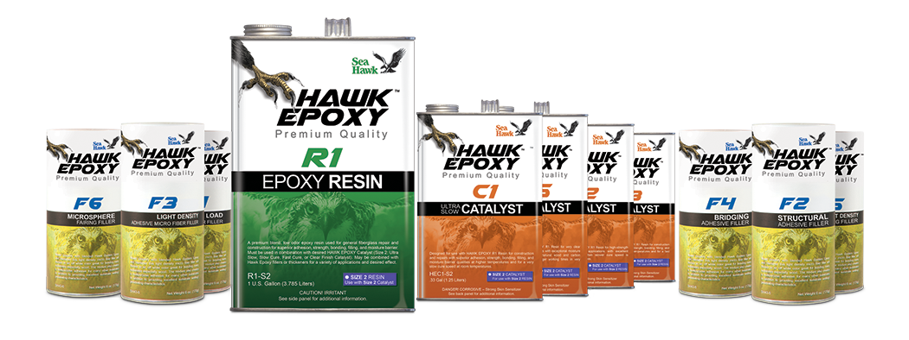
HAWK EPOXY
State-of-the-art Epoxy System for Building and Repairing Almost EVERYTHING
High Tensile Strength
Strong and Durable
Easy to Use
Excellent Bonding Strength
Water Resistant
Cost Effective

Slide 38
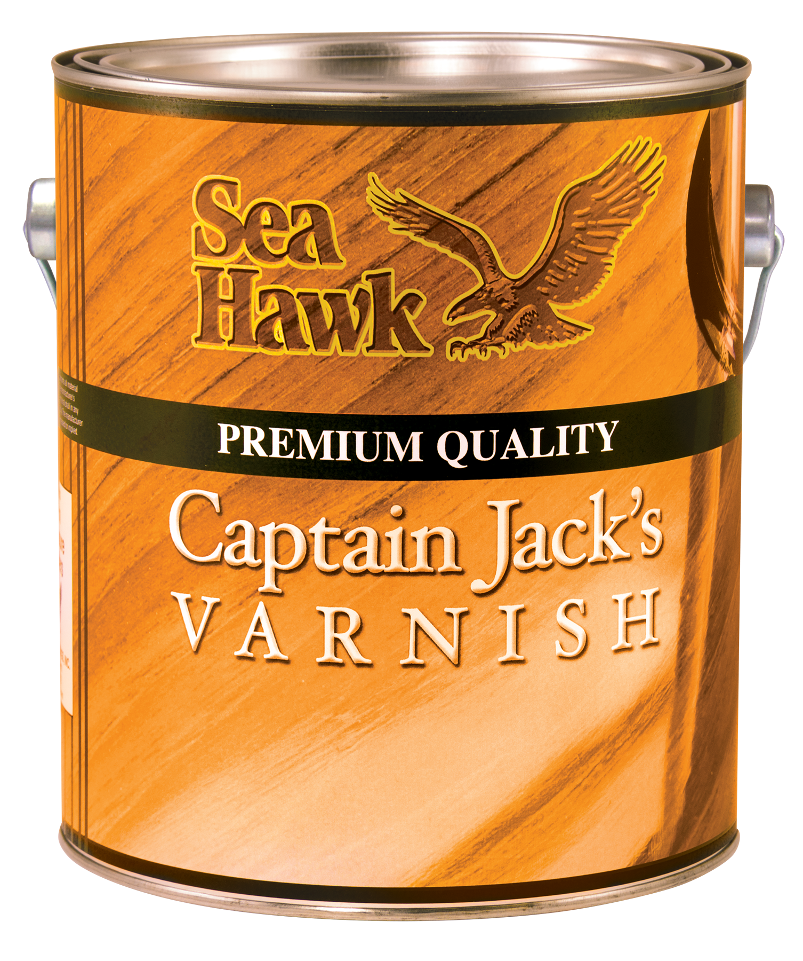
CAPTAIN JACK’S VARNISH
V1000 Series
Premium High-Gloss
Marine Varnish
Easy to apply with excellent brushability
Durable finish with good water resistance
Superior self-leveling properties
Extra UV protection

Slide 39
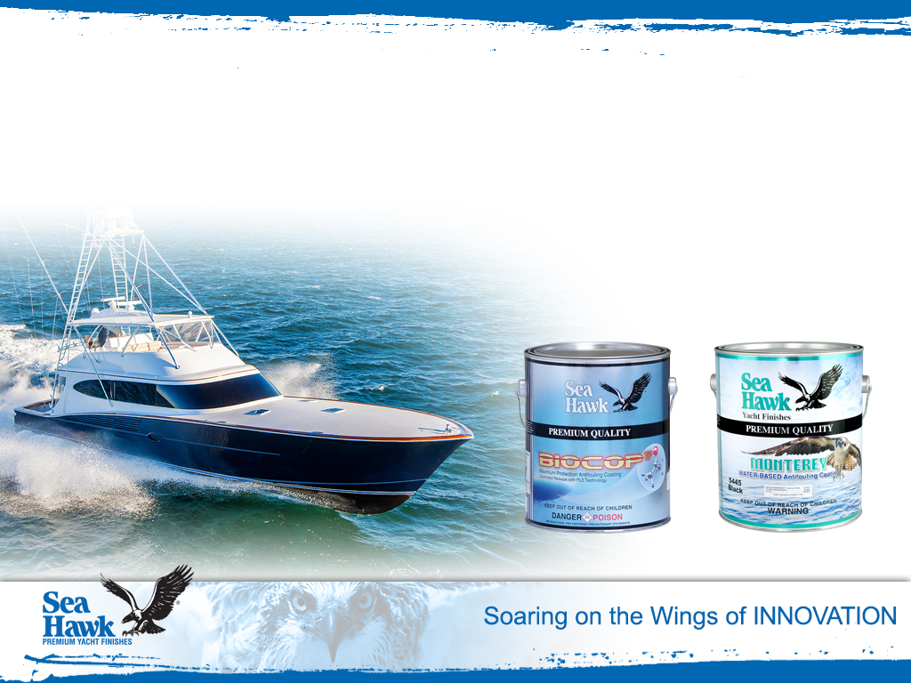
Spring Special
Buy ten gallons of BIOCOP TF
or MONTEREY and get one
FREE!

Slide 40
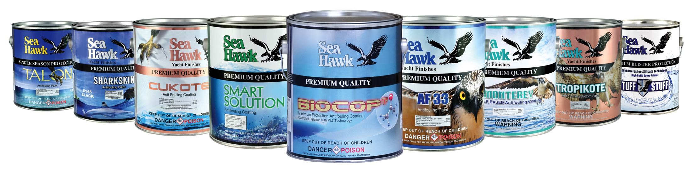
If you are in the area please stop by for a plant tour!

